Slide 1
Industrial Project (234313)
Synthetic images generation using blender
for Deep-Learning model training
Students: Rahaf Abo Ahmad, Safi Azmi
Supervisors: Idan Friedman, Udi Barzelay

Slide 2
Goals
To create a synthetic documents generator which will be used for extracting dataset for training deep learning model under the domain of documents understanding.
For each labeled word/letter/number we have in the original document we want to recognize its location in the synthesized image.

Slide 3
METHODOLOGY
Blender scene setup
Coding:
changing the paper shape
Extracting the labels.
automation and parameters randomization
Testing

Slide 4
Blender scene setup
adding the meshes to the scene, two plane meshes one is the document and the other is the floor
Scene definition: in order to make the scene look realistic we define the materials of the objects, the lightning and the camera.
This part allows us to control the objects, lights and camera in the coding part and randomize their location and the intensity of the light.

Slide 5
Coding
Applying the document image as a texture to the object
Changing the shape of the paper, we support multiple options for the shape:
Flat paper
Folded paper
Wrinkled paper
Bended paper.
Extracting the labels: two main transformations:
Image to scene
World to camera

Slide 6
Extracting the labels algorithm
Divide the mesh faces to triangles (tessellation).
Store the UV coordinates for each triangle loop
Map the bounding box points of a label: for each point
find the closest triangle loop and the triangle that contains this point.
find the barycentric coordinate relative to the triangle
Find the local coordinate of the point using interpolation.
Find the world space coordinate of the point
Find the camera space coordinate of the point
Converting the bounding box camera space points to the render space

Slide 7
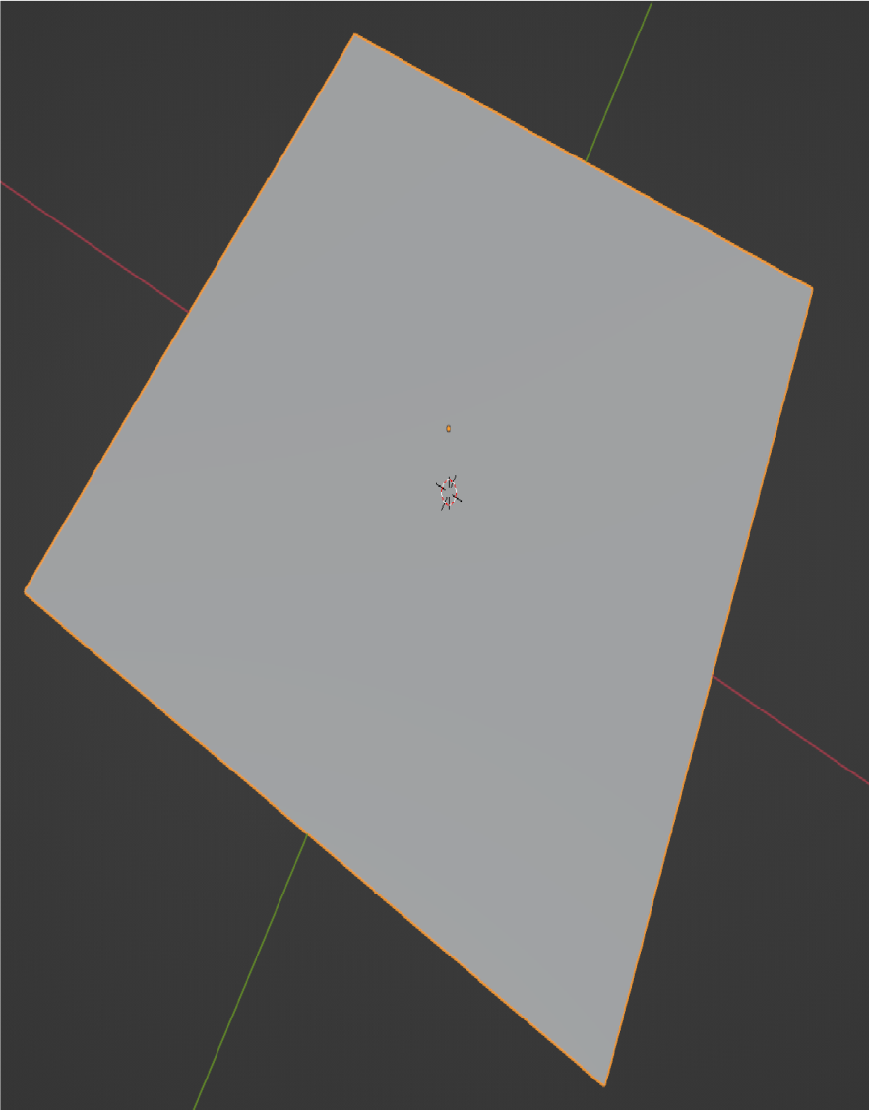
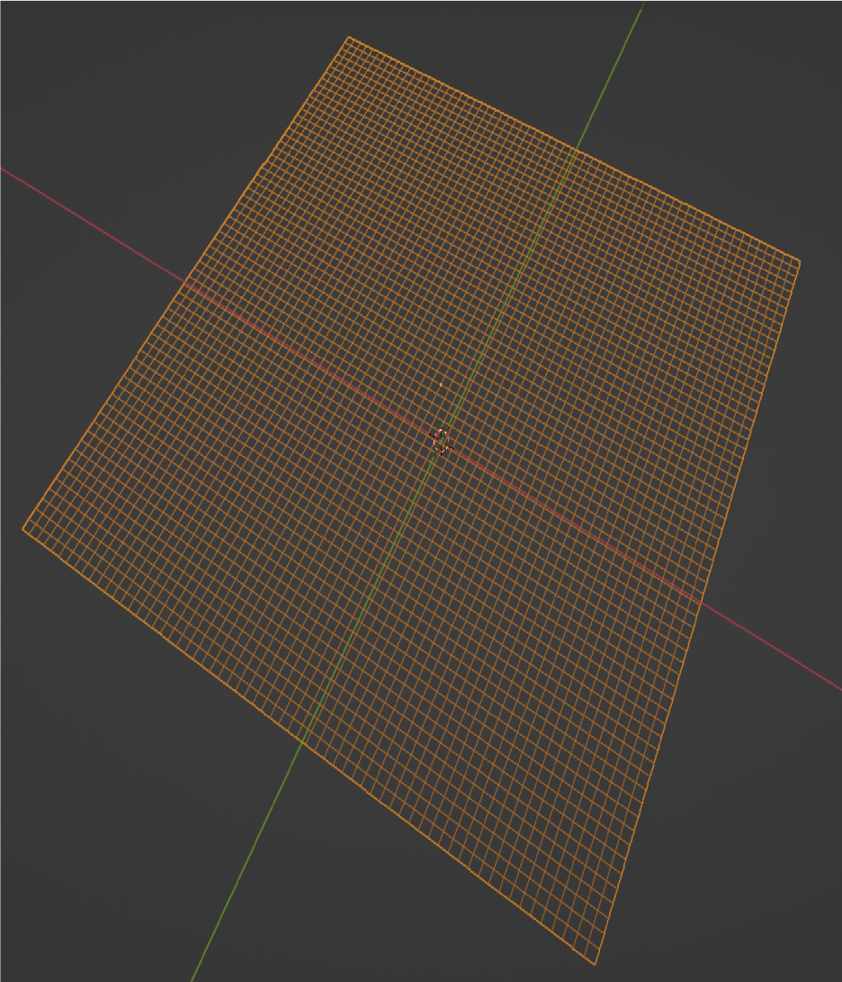
The plane without modifying
The plane’s geometry

Slide 8
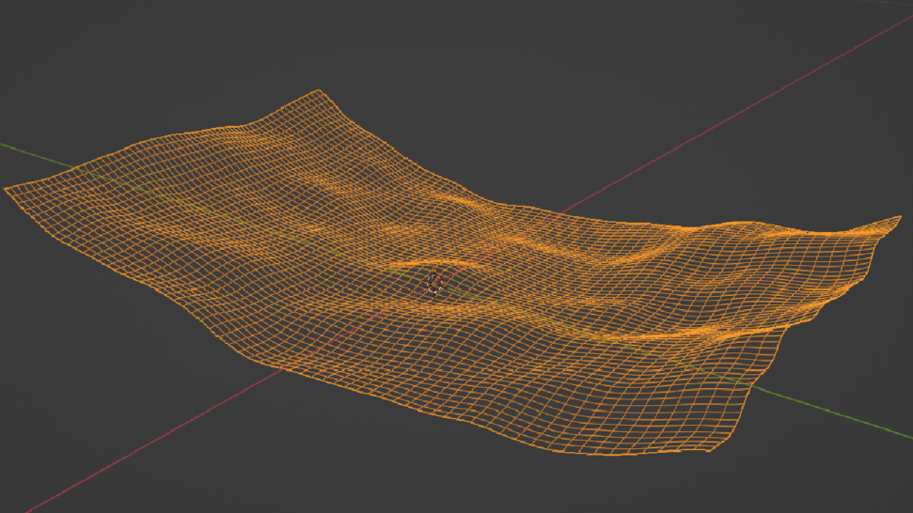
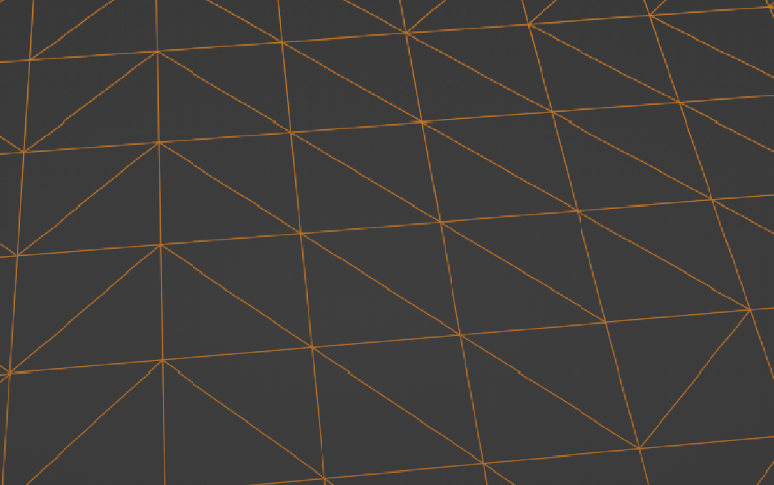
The plane after applying modifiers
Tessellating the faces to triangles

Slide 9
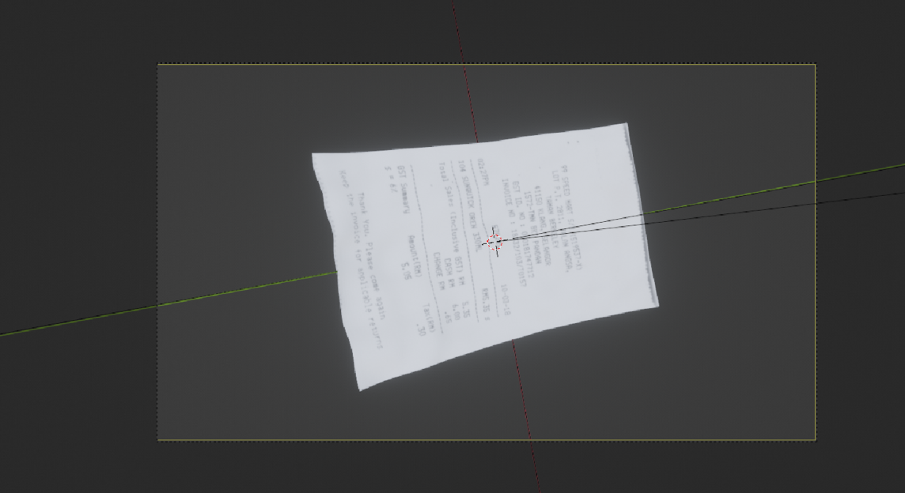
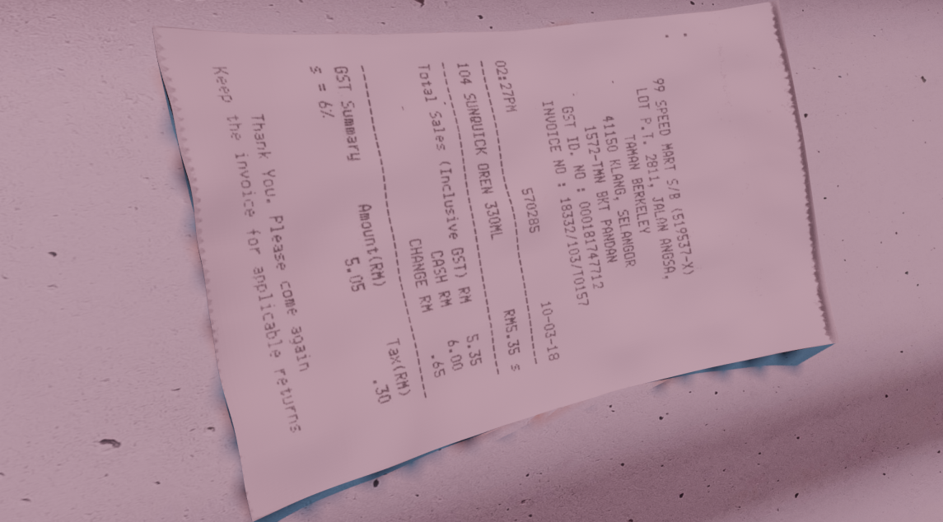
Camera space view:
render space:

Slide 10
automation and parameters randomization
Allows us to automate the render generation
Taking pictures of our object from different angles by moving the camera around the scene. Three loops, each of them modifies one of the angle of the camera the first is the distance from the object the second is the rotation along the X axis and the last is rotation from 0 to 360 degrees around the object .
For every orbit we randomize a texture for the environment and the floor
Randomization of the light intensity, color and location
The user can choose the shape of the paper and the intensity level of the wrinkles/bending angle/folding angle or a mix.

Slide 11
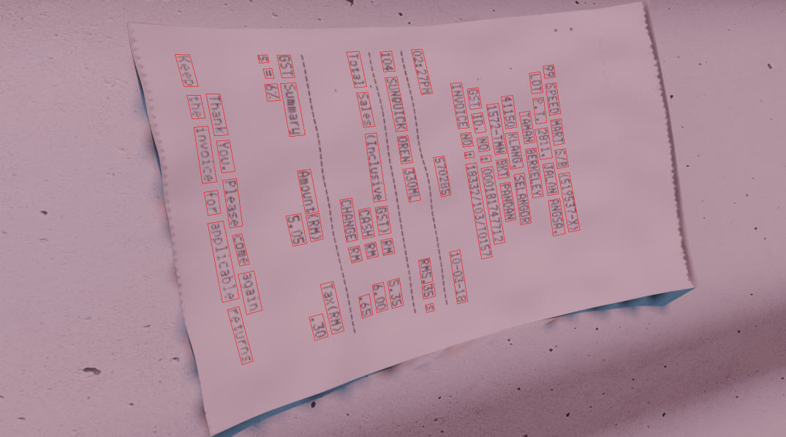
Testing
We added a feature to draw the bounding box around each labeled word to help us check the results.

Slide 12
Achievements
We met our project's main goal: we created a synthetic documents generator
The program creates labeled training data.
The results support that.

Slide 13
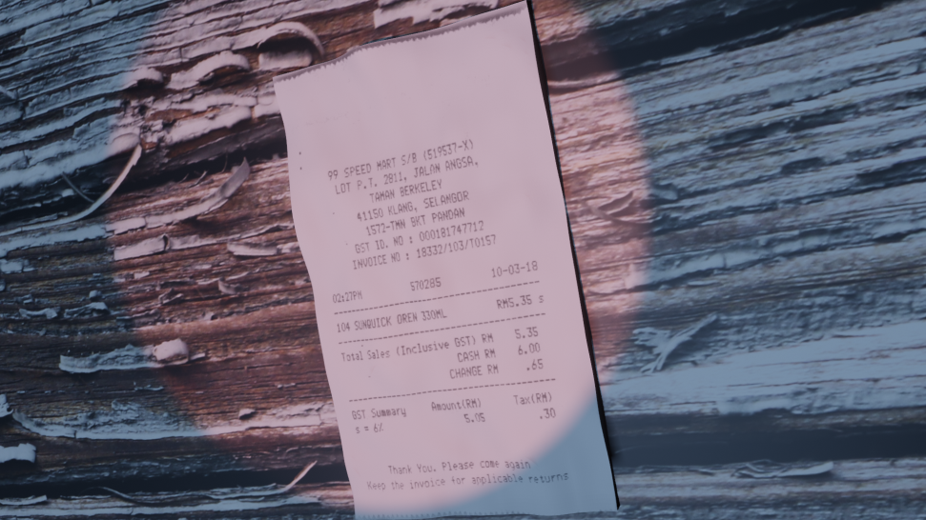

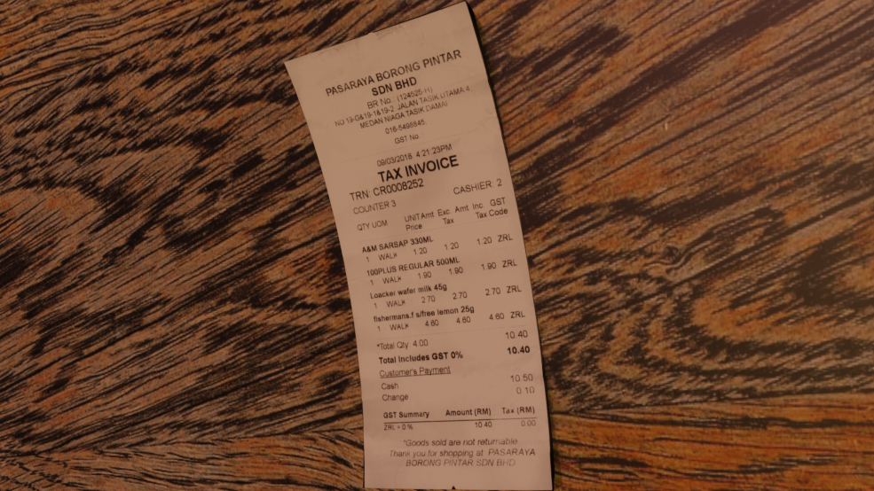

Examples

Slide 14
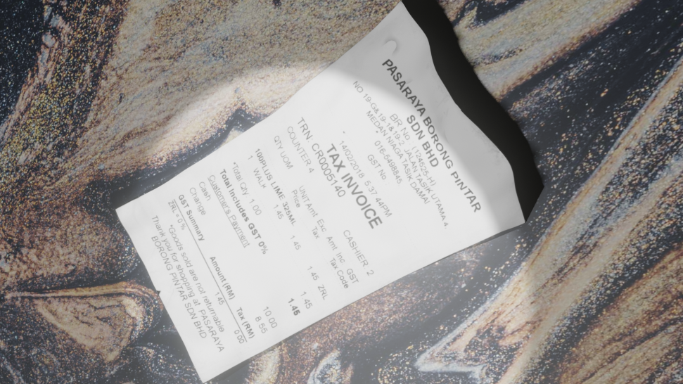
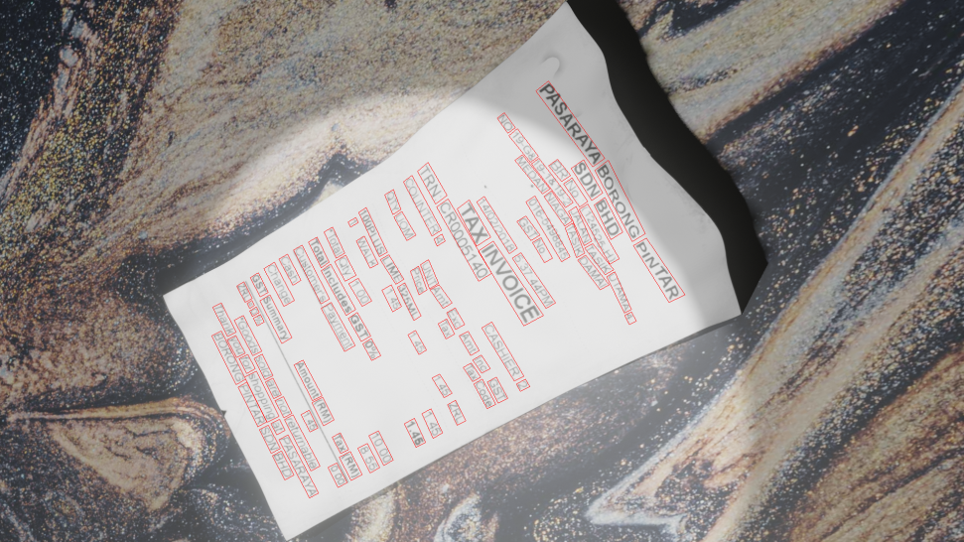
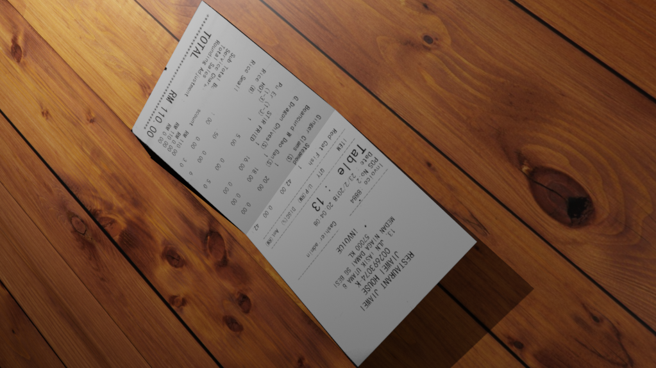


Slide 15
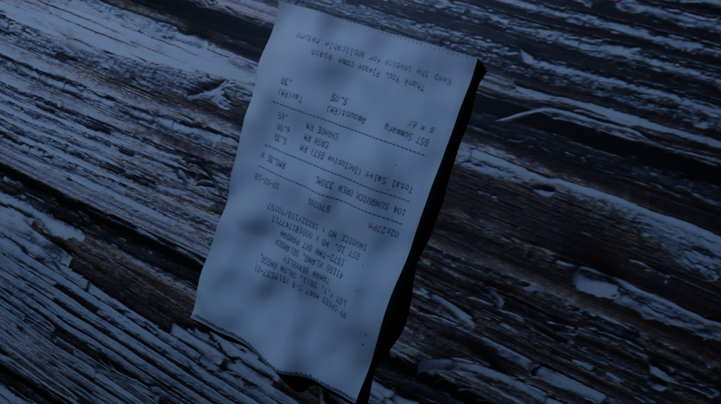
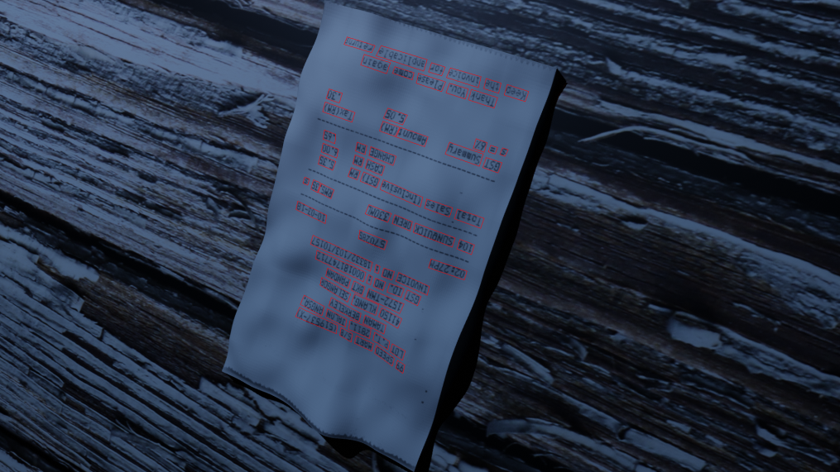
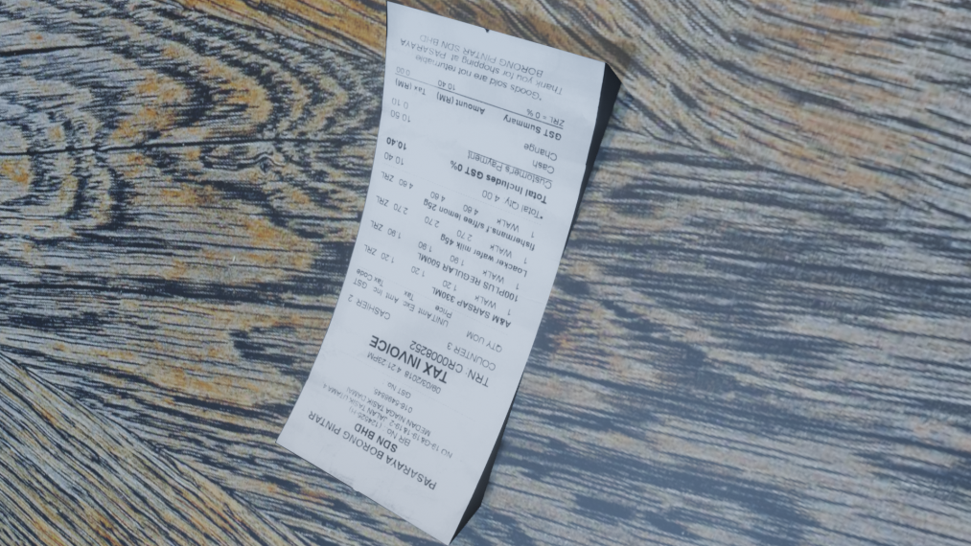
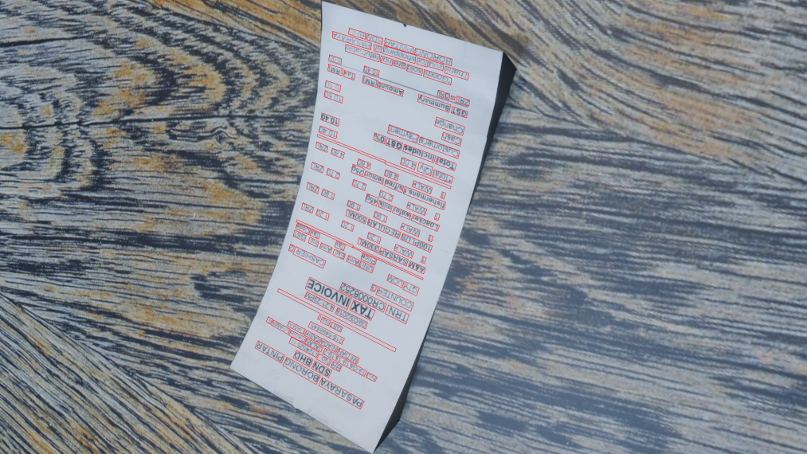

Slide 16
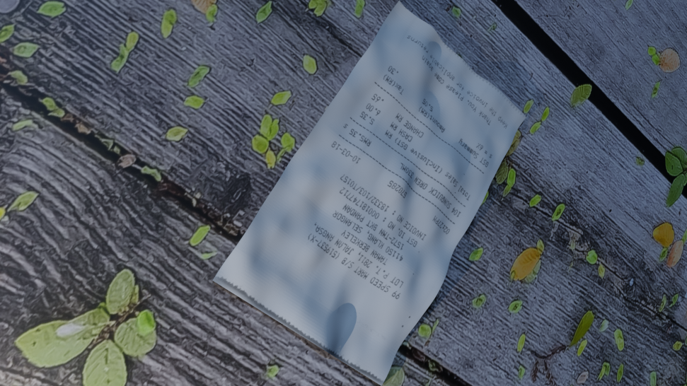
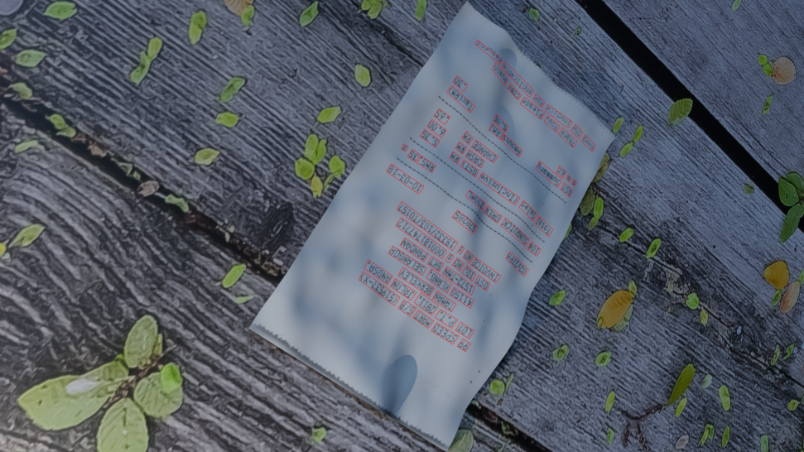
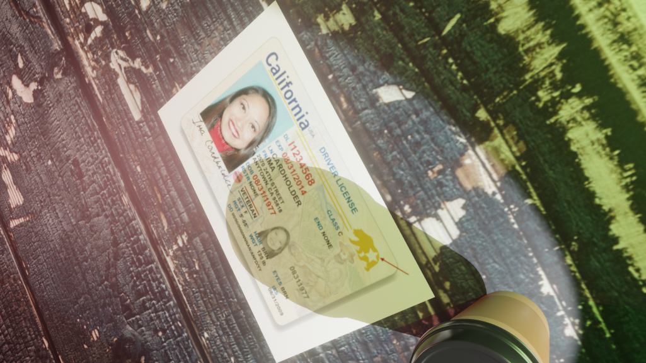
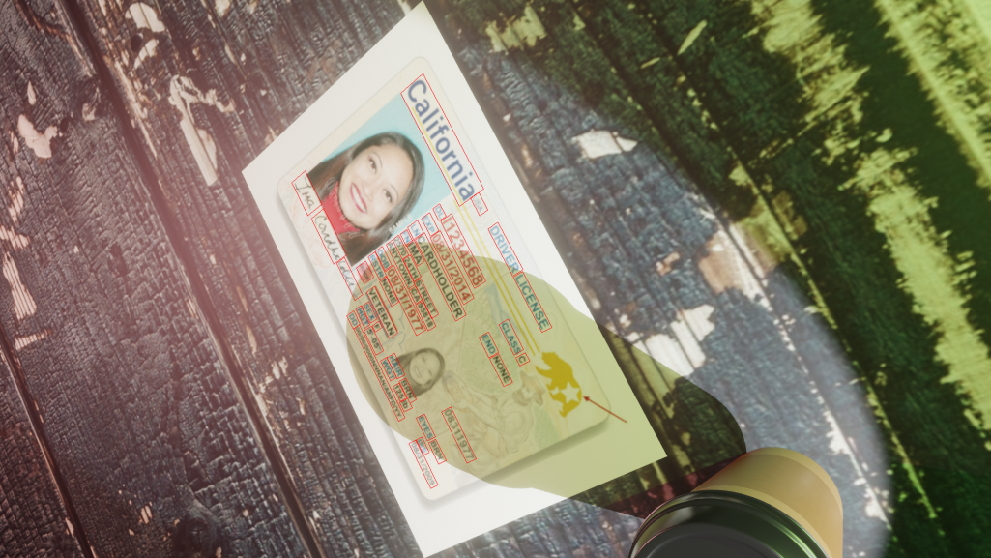

Slide 17
